Slide 1
A resource grammar for Zulu
Laurette Marais
and Laurette Pretorius
(with Lionel Posthumus)
Notes:
Hello. I will be talking about our efforts towards implementing a Zulu resource grammar. Our efforts are, specifically, the efforts of my colleague/mother, namely Laurette Pretorius, and I, and we are privileged to work with Prof Lionel Posthumus, one of the top Zulu linguists in South Africa.

Slide 2
Outline
Zulu and its resources
Characteristic features
Agglutinating morphology
Nominal classification
Concordial agreement
Tour of the Zulu RG
Mostly the noun phrase
Quick remarks on verbs
Notes:
My talk will follow this outline here. I will say some things about Zulu and its resources, and then I will very briefly discuss its most characteristic features as a Bantu language.
Namely, it has an agglutinating morphology. It has a nominal classification system - that means that all nouns stems belong to one or more noun classes. Agreement in Zulu is based on these noun classes and the morphemes responsible for indicating agreement are commonly called concords. Lionel, our Zulu expert, prefers not to call them that, because the term is somewhat overused - everything ends up being a concord. However, I might still call them that in this talk, just because the term is used widely.
The meat of the talk will be a kind of tour of the Zulu RG, focusing mainly on the noun phrase.

Slide 3
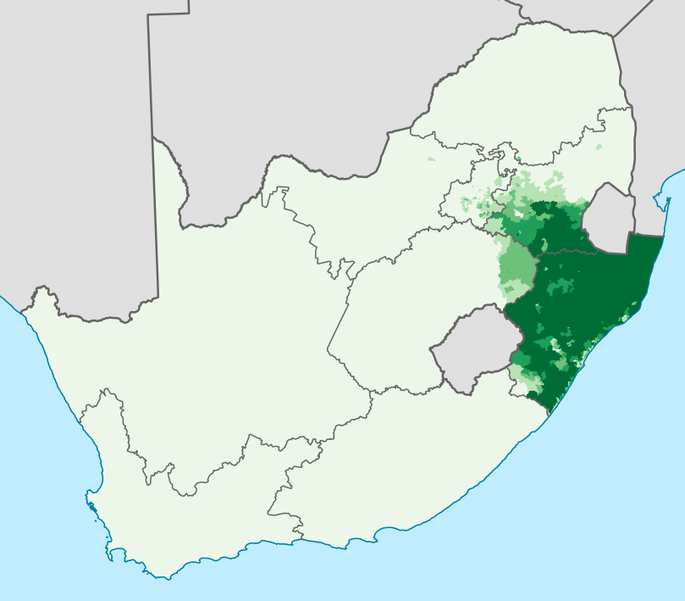
Zulu
Bantu → Southern Bantu → Nguni
One of 11 official languages of South Africa
~11.5M home language speakers as of 2011
Largest home language in South Africa
Understood by 50% of South Africans
Second most widely spoken Bantu language after Swahili
9 174 Wikipedia articles (mostly stubs), 28 active registered users
https://en.wikipedia.org/wiki/Zulu_language, image: https://commons.wikimedia.org/w/index.php?curid=28087429
Notes:
Here are a few orientating facts about Zulu. It belongs to the Nguni group, which is located in the Southern Bantu group, which of course form part of the Bantu language family.
It is one of elevent official languages of South Africa.
In 2011 the national census found that around 11.5M people spoke Zulu as a home language, and it is understood by about half of South Africans.
It is the second most widely spoken Bantu language after Swahili and it has almost 10 000 Wikipedia articles. As I mentioned yesterday, however, most of them seem to consist of single sentences.

Slide 4
Zulu NLP resources
ZulMorph - XFST morphological analyser
WordNet project
NCHLT monolingual corpus - 1.4M sentences
JW300 corpus - 1.1M sentences
Autshumato Eng-Zul parallel corpus - 35k sentences
isizulu.net - not directly an NLP resource, but very useful
Resource grammar WiP¹
https://github.com/LauretteM/gf-rgl-zul
Notes:
Here is a very basic snapshot of resources available for Zulu. It has an XSFT morphological analyser, developed by the other Laurette and Sonja Bosch.
The latter is also currently involved in a WordNet project, aimed at revamping or improving the WordNet already in existence.
The largest curated monolingual corpus I am aware of is the NCHLT corpus, made up mostly of text scraped from government documents.
There are two commonly used English-Zulu parallel corpora - the JW300 corpus containing mostly religious text, and the Autshumato corpus, which is also made up of government website data.
Then, of course, we are now working on a resource grammar. The code is available at the link below. Github does not allow you to make two different forks of the same project. I had already made a fork to work on the Afrikaans, so that I made a new copy to keep the projects separate.

Slide 5
Characteristic features
Agglutinating morphology (conjunctive orthography)
Nominal classification
18 noun classes (depending on how you count)
also called class gender
Concordial agreement of nouns with
verbs, copulatives, relative clauses, adjectives, demonstratives…
uTatjana uzozuza indonda yegolide (Tatjana will win the gold medal)
ya + igolide = yegolide
In GF, this means allomorphs and BIND (&+)
uTatjana u &+ zo &+ zuza indonda ye &+ golide
Notes:
Ass mentioned earlier, the morphology of Zulu is agglutinating and it has a conjunctive orthography. This distinguishes it from related Southern Bantu languages that have a disjunctive orthography, which basically means that verb prefixes tend to be written as separate tokens. In Zulu, however, verb prefixes are written as part of the verb token.
So, depending on how you count, there are 18 different noun classes. This feature is also called class gender by some linguists, and we have found that to be a useful term, as it does indeed behave similar to gender in other languages.
Nouns agree with all sorts of things around them, namely verbs, copulatives, relative clauses, adjectives, demonstratives etc.
Here is a little example to give you a taste. The noun prefix u in uTatjana agrees with the subject concord prefix u in uzuze. The possessive concord in front of the noun igolide is ya, which agrees with indondo. Here we also have an example of morpheme fusion -> ya and i become ye.
The verbs, for example, can take on hundreds of forms, which, if you implement the morphology in the traditional way, causes the compiled grammar to contain thousands of strings that it is unlikely to use during runtime. The grammar becomes unmanageable with even a tiny toy lexicon. The way around this, at least for now, maybe, is to treat the morphology as syntax. You let the compiler create all the pieces of string you’ll need, as though these were the tokens in your grammar, and then you insert the BIND token to let the runtime know to stick them together. In this example, we treat ya and ye as allomorphs of each other - basically different versions of the same morpheme. We also do this with igolide and golide. When they encounter each other, you use some parameters to figure out which versions to stick together to create morphologically sound tokens.

Slide 6
Noun classes
Class | Typical nouns | Prefixes | Subject concords | Object concords
1-2 | persons | umu- / ab(a)- | u, w, ka, e, a, wu / ba, b, be | m, mu / ba, b
1a-2a | proper names, titles | u- / o-
3-4 | nature | umu- / imi- | u, w, wu / i, y, yi | wu, w / yi, y
5-6 | anatomy, birds, fruits, loan words... | i(li)- / ama- | li, l / a, , wa, e | li, l / wa, w
7-8 | anatomy, attitudes, collectives... | isi- / izi- | si, s / zi, z | si, s / zi, z
9-10 (-6) | animals, anatomy, tools... | iN- / isiN- | i, y, yi / zi, z | yi, y / zi, z
11 (-10) | misc, diminutive significance | u(lu)-, lw- | lu, lw | lu, lw, l
14 | abstract | ubu-, u- | bu, b | bu, b
15 | infinitives | uku-, uk-, ukw- | ku, kw | ku, k
16, 17, 18 | locatives | ku- / [pha-, mu-] | ku, kw | ku, k
Notes:
Okay, so here are the 18 noun classes. I don’t know why they skipped the names of 12 and 13 (maybe Laurette knows).
Most nouns belong to two classes, one for singular and one for plural, so the classes can be paired in this way. 1-2, 3-4, 5-6, etc. However, some nouns belong to, for instance, class 9 in the singular and class 6 in the plural.
Then, there are some semantic themes that can be identified in the classes. Class 1 and 2 are always people, and Class 1a and 2a contain names and titles of people.
Each class is associated with its prefix, and this prefix identifies the class the noun belongs to. Then, just to give some idea of how the concordial agreement with verbs work, I’ve added the subject and object concords. Predicates always contain a subject concord, while the use of the object concord is a bit more fluid. Both the subject and object concord can stand in for noun phrases, so you can basically have prodrop on both the subject and object.
The last row contains the so-called locative classes. We’ll get back to this later, but for now it’s worth saying that only class 17 has an associated concords and functions more typically like a noun. The other locatives are more adverbial in nature.

Slide 7
Noun classes
Class | Prefixes | -ntu |  | -Zulu/zulu
1-2 | umu- / ab(a)- | umuntu, abantu | person, people | umZulu, abaZulu | Zulu person, people
1a-2a | u- / o- |  |  | uZulu, oZulu | Mr Zulu, Mr Zulu and co
3-4 | umu- / imi-
5-6 | i(li)- / ama- |  |  | izulu, amazulu | sky, heavens
7-8 | isi- / izi- | isintu | mankind | isiZulu | Zulu language/culture
9-10 (-6) | iN- / isiN-
11 (-10) | u(lu)-, lw-
14 | ubu-, u- | ubuntu | humanity
15 | uku-, uk-, ukw-
16, 17, 18 | ku- / [pha-, mu-] |  |  | phezulu | above
Notes:
Here are just some examples to show how meaning is somewhat associated with the different noun classes. It’s not extremely common, but some noun stems appear in more than two classes.
Discuss.

Slide 8
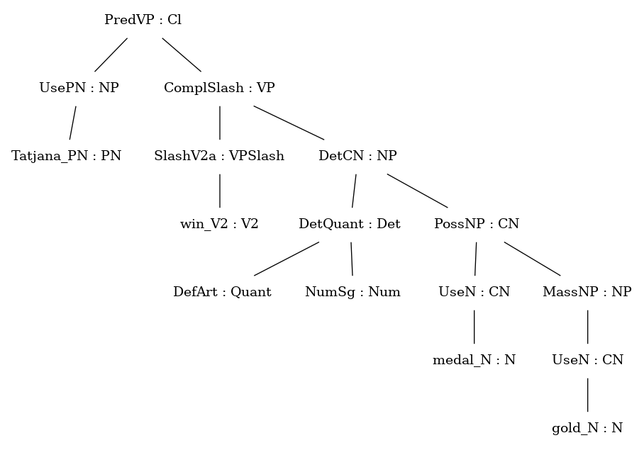
Basic morphosyntax of Zulu
Present | Positive | uTatjana uzuza indondo yegolide
Recent past | Positive | uTatjana uzuze indondo yegolide
Remote past | Positive | uTatjana wazuza indondo yegolide
Remote past | Negative | uTatjana akazuzanga indondo yegolide
Immediate future | Positive | uTatjana uzozuza indondo yegolide
Immediate future | Negative | uTatjana akazuzuza indondo yegolide
O | subject concord, class 1a
O | tense prefix
O | negative prefix
O | root + terminative suffix
O | possessive concord, class 9 (class 5)
Notes:
Here we have an example of a clause rendered in the basic tenses, in the principle indicative mood, with some variation in the polarity. I’ve added some colours to show where morphemes have been bound together at runtime.
Green is the subject concord in each case. Note that it changes in two spots. In the remote past, the underlying form is still u, but it undergoes a phonological change in the presence of the past tense prefix a. In the negative, it changes entirely to ka. For our purposes, we treat all three versions as allomorphs.
Red is the tense prefix - it can be a in the remote past and zo or zu in the immediate future, depending on polarity. It’s a slight remnant of the miniature resource grammar that we haven’t implemented the remote future yet, but unless I’m mistaken, the tense prefix would then be yo or yu.
The negative prefix a can be seen in the two negative sentences, and note that in the remote past, you have to use a different suffix, namely anga, and there is no explicit tense prefix a.
Okay, so that should give you a taste of how Zulu works.

Slide 9
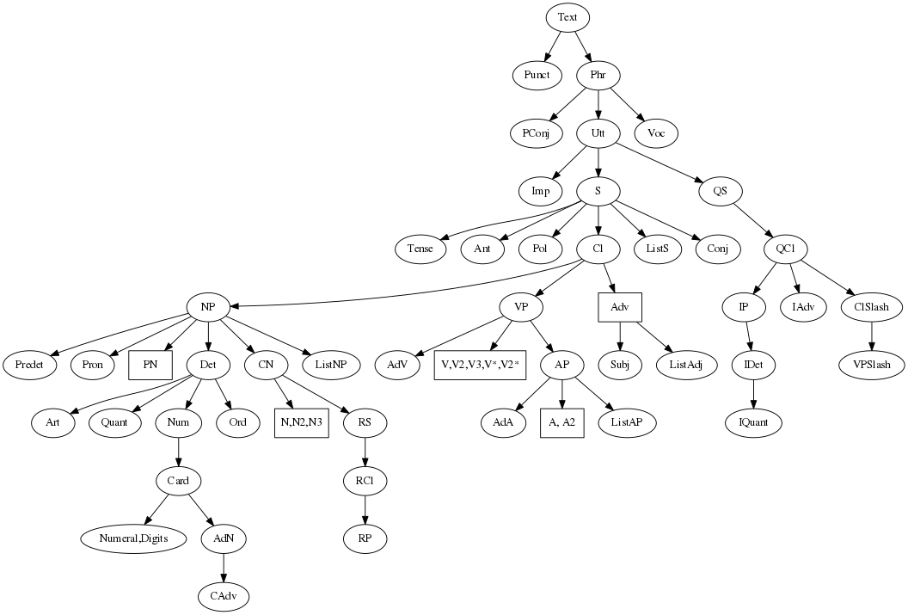
Tour of the Zulu RG
Notes:
I grabbed this from the GF website. Unless I’m mistaken, it’s a bit outdated, but it still does a decent job of giving an overview of the different categories in the resource grammar abstract syntax.

Slide 10
Noun phrases
Notes:
Today, I’ll be spending most of the time in the bottom left corner, talking about the noun phrase.

Slide 11
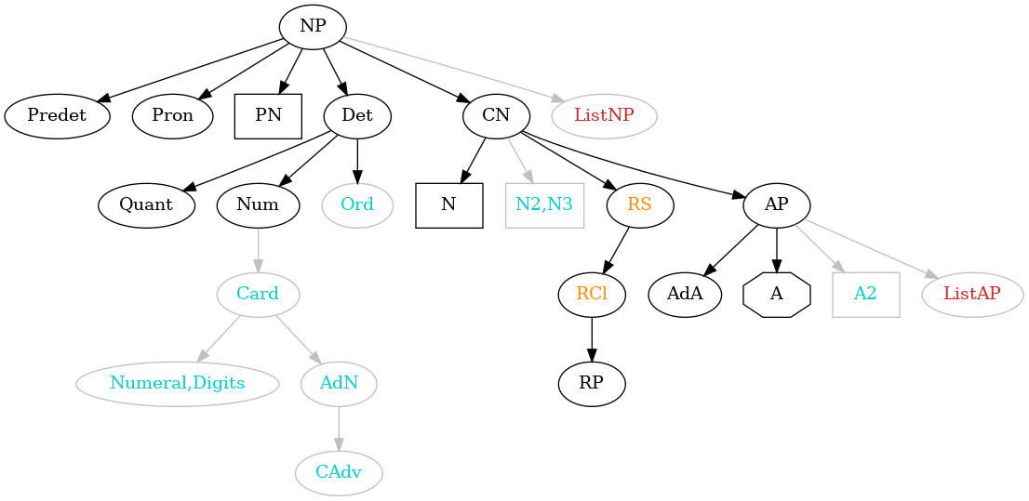
Noun phrase so far
Black - mature
Orange - under development
Red - not yet implemented
Cyan - on ice
Notes:
Here I’ve made a slightly edited version of that part of the graph, and I’ve assigned some colours.
Black means that we’re basically happy with the linearisation category of that category, and we’ve dealt with the most important functions needed to construct it.
Orange means that we have done significant work on the category, but we still have some ironing out to do.
Red means it has not been implemented yet, and I have to be honest, I still need to figure out how to do the List categories. My attempts haven’t been very successful so far, for some reason.
The controversial colour here is the cyan. That means the category itself is currently on ice. That doesn’t mean that we don’t plan to implement it at all, but it does mean that we either have no idea how to make it work for Zulu at the moment, or we know that Zulu uses other categories and constructions to achieve the same effect.

Slide 12
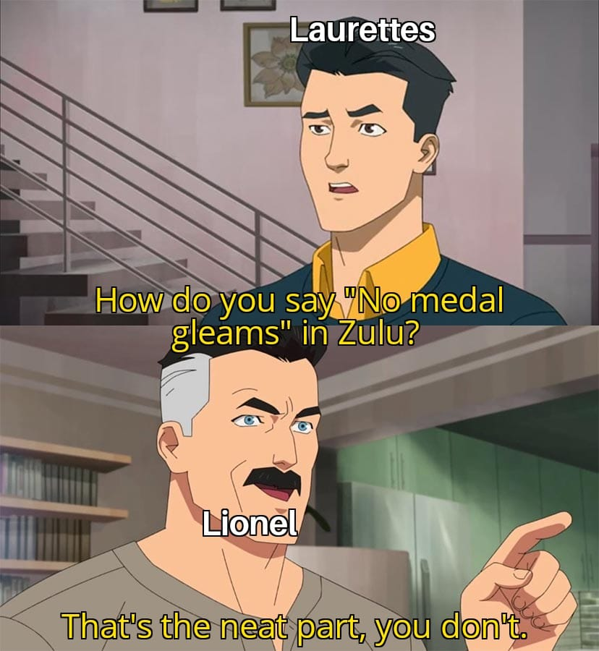
Noun phrase so far
Black - mature-ish
Orange - under development
Cyan - on ice
Red - not yet implemented
Notes:
As we go along, it will become clear that, for now, we are taking a few liberties with the RG abstract syntax.
There are three main reasons for this
The Zulu grammar has a tendency to blow up - we need to keep it compileable at all times, so we are only implementing things we are reasonably sure about. By that, I mean that we can’t wait half an hour for the Res or Sentence module to compile whenever we make changes. It just slows us down too much. Also, we’re using about 40GB of RAM during compilation, and at the moment, we only have about 100GB, that we share with colleagues, to work with.
Zulu linguistics has never been studied with such a strong focus on “fitting in” with a kind of universal conception of grammar, so we’re doing a lot of figuring out as we go. Sorting out form and function is a lot of two steps forward, at least one step back.
This also means that we can’t optimise too early, because backtracking becomes very difficult. We try to make the code as self-documenting and reflective of the linguistics as far as possible. Hence, we have to make up for non-optimal choices now by waiting to implement things that seem redundant.
Our goal is to produce something useful! It has to, on the one hand, be a recogniseable implementation of Zulu, but we also want to participate in the multilingual advantages of the RGL.
With that said, here’s more or less what I’ll be talking about next.
Tour:
N and CN
“Adjectives” - includes the adjective stems, the primitive relative stems and the enumerative stems. You’ll notice that I’ve changed the shape of the A node. That’s because adjectives (which we take to include primitive relative stems and enumerative stems) are not an open class in Zulu, although they do occur very frequently.
Let’s consider Det and its related categories. We’re keeping Card and Ord on ice, so the only Nums left are Sg and Pl, which are pretty straight forward. What remains to discuss is Quant.
Pronouns
Pre and post determiners

Slide 13
Nouns
Params
ClassGender | C1_2 | C1a_2a | C3_4 | C5_6 | C7_8 | C9_10 | C11_10 | C9_6 | C14 | C15 | C17
NForm | Full | Reduced | Poss | Loc
Agr | First Number | Second Number | Third ClassGender Number
Number | Sg | Pl
khundla_N (stadium)
s | Sg | Pl
Full | inkundla | izinkundla
Reduced | nkundla | zinkundla
Poss | nkundla | zinkundla
Loc | enkundleni | ezinkundleni
c | C9_10
Lincat of N
s | Number => NForm => Str
c | ClassGender
Lincat of CN
s | Number => NForm => Str
mod | Number => Str
c | ClassGender
?
Notes:
This slide shows the implementation of the noun and common noun lincats in a nutshell.
First, we look at the relevant parameters. You can see that we’ve paired the noun classes where relevant, so that any given noun stem (or, more accurately noun stem sense) is associated with only one class gender value.
Then, we have four forms of the noun stem that function somewhat like allomorphs. The full form includes the prefix, the reduced form drops any leading vowel. The possessive form for nouns is the same as the reduced form, but the parameter is retained all the way up to the noun phrase level, so it is used for pronouns as well, where the possessive form is different. Finally, we have the default locative form, which in most cases is the stem with an e prefix and an ini suffix. We have a bunch of nice paradigms that sort out the phonological changes that can happen here.
Our agreement parameter uses person as a constructor, and includes class gender in the third person.
Of course, we get the Number parameter from the ParamX module.
Okay, so a N has a table for the strings that depends on NForm, and it keeps its class gender as an inherent feature. On the right, you can see how this looks for the stem khundla (meaning stadium).
You would expect that the lincat of CN is identical, but we have actually had to split the string fields, to separate the noun itself from the modifier.

Slide 14
Nouns
Params
ClassGender | C1_2 | C1a_2a | C3_4 | C5_6 | C7_8 | C9_10 | C11_10 | C9_6 | C14 | C15 | C17
NForm | Full | Reduced | Poss | Loc
Agr | First Number | Second Number | Third ClassGender Number
Number | Sg | Pl
indondo
le ndondo
yona le ndondo
le ndondo yona
le ndondo enkulu
le ndondo yona enkulu
medal
this medal
this very medal
this medal, on the other hand
this big medal
this big medal, on the other hand
Lincat of N
s | Number => NForm => Str
c | ClassGender
Lincat of CN
s | Number => NForm => Str
mod | Number => Str
c | ClassGender
?
Notes:
The reason is that you can use the pronoun associated with a noun to indicate emphasis or contrast. For example, …
Note that this use of the pronoun is not modification, as such, and it’s not immediately clear at what level it should operate. Is it a function on the common noun, since it gets inserted before the adjective for contrast, or is it a function on the noun phrase, which is why it is inserted before the quantifier for emphasis? Linguists consider it to be one phenomeno, but maybe it makes sense to deal with emphasis and contrast as two kinds of things in GF?
We’ll talk some more about it later, but this is typical of the questions that pop up all the time.

Slide 15
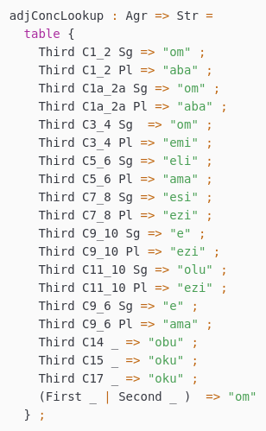
“Adjectives”
Zulu adjectives are a closed class.
There are three kinds of “adjectives” (qualificatives)
adjective stems
primitive relative stems
enumerative stems
Adjective
Relative
Enumerative
ngibona umgijimi omkhulu
ngibona umgijimi oqotho
ngibona umgijimi mumbe
I see the big sprinter
I see the honest sprinter
I see the other sprinter
Notes:
Now, we get to adjectives.
In Zulu, they are a closed class, and we have decided to group together three different kinds of modifiers, typically called qualificatives, into the A category. These are
Adjective stems
Primitive relative stems
Enumerative stems
They are similar in that they take a single concord to agree with the noun, but they take different ones. On the right, you can see the table for the adjective stem concord, which is a table from agreement to string.

Slide 16
“Adjectives”
Params
AForm | AF1 | AF2 | AF3
AType | AdjType | RelType | EnumType
khulu_A (big)
s | AF1 | khulu
 | AF2 | nkulu
 | AF3 | khulu
t | AdjType
Lincat of A, AP
s | AForm => Str
t | AType
Notes:
We need two parameters to deal with the morphology and sound changes of adjectives.
AForm allows us to deal with sound changes that occur in or around the adjective stem depending on which noun it modifies.
AType allows us to choose the correct agreement morpheme for the different kinds of “adjectives”.
You can see the sound change that happens inside of khulu when it is prefixed with a nasal.

Slide 17
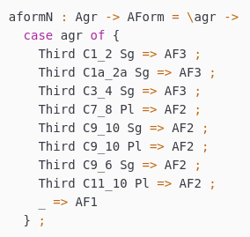
“Adjectives”
Params
AForm | AF1 | AF2 | AF3
AType | AdjType | RelType | EnumType
khulu_A (big)
s | AF1 | khulu
 | AF2 | nkulu
 | AF3 | khulu
t | AdjType
hle_A (beautiful)
s | AF1 | hle
 | AF2 | nhle
 | AF3 | uhle
t | AdjType
Lincat of A, AP
s | AForm => Str
t | AType
qotho_R (honest)
s | AF1 | qotho
 | AF2
 | AF3
t | RelType
mbe_E (other)
s | AF1 | mbe
 | AF2
 | AF3
t | EnumType
Notes:
Here are examples of different types of “adjectives”.
Hle, meaning beautiful, is like khulu a real adjective, but it is also, in addition, monosyllabic. For such adjectives, we need three versions of the stem. On the right, you can see the oper that helps decide the form of the stem, and it depends entirely on the noun with which the adjectives must agree.
Relative and enumerative stems are not subject to these phonological changes, so their tables just contains copies of the stem itself.

Slide 18
“Adjectives”
Params
AForm | AF1 | AF2 | AF3
AType | AdjType | RelType | EnumType
khulu_A (big)
s | AF1 | khulu
 | AF2 | nkulu
 | AF3 | khulu
t | AdjType
hle_A (beautiful)
s | AF1 | hle
 | AF2 | nhle
 | AF3 | uhle
t | AdjType
Lincat of A, AP
s | AForm => Str
t | AType
ngibona isiziba esihle
ngibona indondo enhle
ngibona umgijimi omuhle
I see the beautiful pool
I see the beautiful medal
I see the beautiful sprinter
Notes:
Let’s look at what happens to an adjective like hle when modifying different nouns.
AF1 is the stem itself, unchanged.
AF2 is to be used with nouns from classes 8, 9 and 10.
AF3 is to be used with nouns from classes 1, 1a and 3, but is only different from AF1 if the adjective is monosyllabic.

Slide 19
Quantifiers
dem_pron | Dem1 | Dem2 | Dem3
Third C1_2 Sg | lo | lowo | loya
Third C1_2 Pl | laba | labo | labaya
Third C3_4 Sg | lo | lowo | loya
Third C3_4 Pl | le | leyo | leya
Third C5_6 Sg | leli | lelo | leliya
Third C5_6 Pl | la | lawo | lawaya
Third C7_8 Sg | lesi | leso | lesiya
Third C7_8 Pl | lezi | lezo | leziya
Third C9_10 Sg | le | leyo | leya
Third C9_10 Pl | lezi | lezo | leziya
... | ... | ... | ...
IndefArt, DefArt : Quant
this_Quant, that_Quant, yonder_Quant : Quant
Params
QuantDef | Article Definiteness | Demonstrative Distance
Definiteness | Indef | Def
Distance | Dem1 | Dem2 | Dem3
Notes:
We have implemented the following quantifiers
Articles - both the definite and indefinite article are empty in Zulu
Demonstratives - there are three distances for demonstratives in Zulu
Reference to this, that and yonder is a slight approximation of the meaning in Zulu. In actual fact, the first distance is used to point to things close to the speaker. The second distance is used to point to things close to the hearer. The third distance is used to point to things far from both speakers.
These parameters help us to capture the structure of the Quant category for Zulu.
The dem_pron table contains all forms of the demonstratives in one place.

Slide 20
Quantifiers
IndefArt, DefArt : Quant
this_Quant, that_Quant, yonder_Quant : Quant
indondo iyakhazimula
le ndondo iyakhazimula
leyo ndondo iyakhazimula
leya ndondo iyakhazimula
a/the medal gleams
this medal gleams
that medal gleams
yonder medal gleams
Params
QuantDef | Article Definiteness | Demonstrative Distance
Definiteness | Indef | Def
Distance | Dem1 | Dem2 | Dem3
Where is no_Quant?
Lincat of Quant
s | Str
qdef | QuantDef
Notes:
s field is (so far) empty, and the qdef field is used to decide
The form of the determiner
The form of the noun!
If qdef is an article, whether definite or indefinite, this always means that there quantifier itself has no string, and in almost all cases, the full form of the noun is used (we’ll get back to this).
If qdef is a demonstrative, the reduced form of the noun is used, and the distance decides which string to grab from the dem_pron table.
Why did we not implement no_Quant?

Slide 21
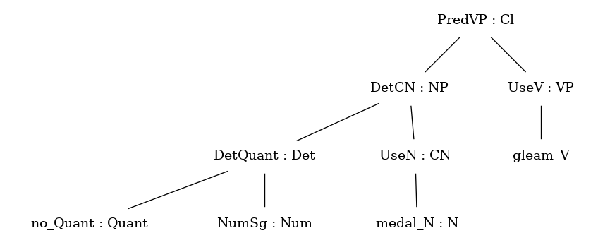
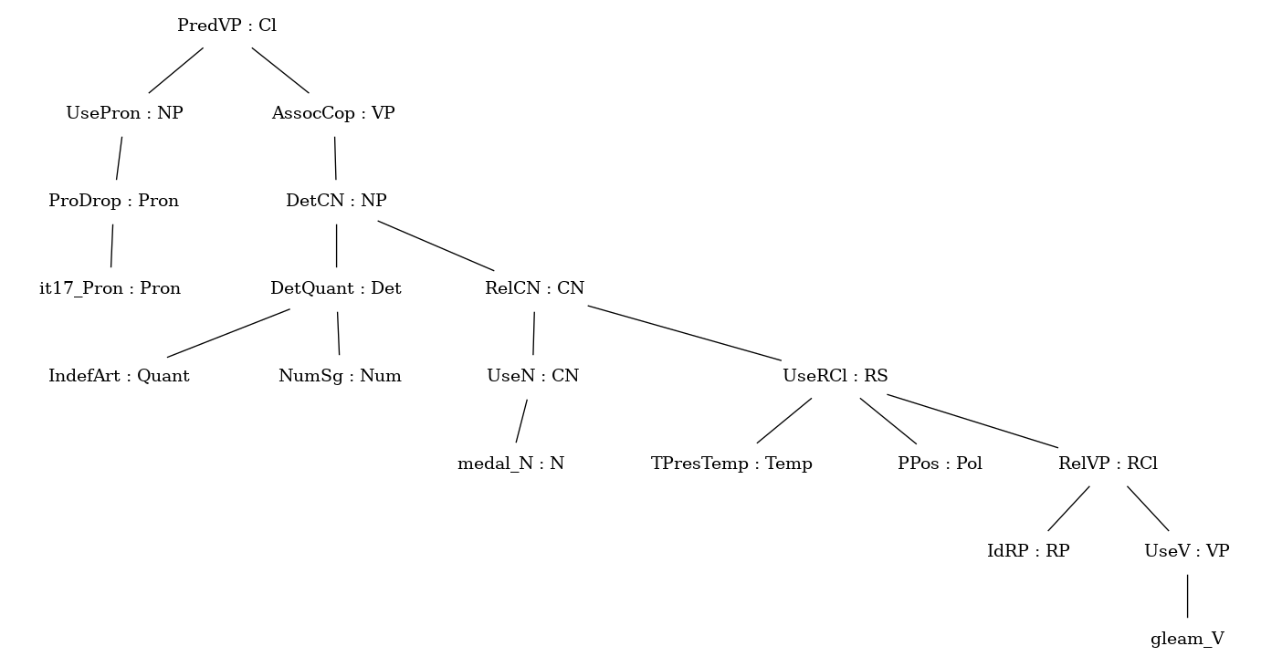
Quantifiers
akunandondo ekhazimulayo
there is no medal that gleams
Literally: it is not with a medal that gleams
Trees ...
no medal gleams
Notes:
There is no no_Quant in Zulu.
You have to paraphrase, and in a rather drastic way.
You have to say “There is no medal that gleams”, or literally, “it is not with a medal that gleams”.
Which is an entirely different sentence, with its own morphosyntactic realities. Importantly, the grammar can express this sentence (even without the functions for this kind of existential expression in the Extra module of the RG).
This is an example of where we try to avoid implementing paraphrases that would slow the grammar down without adding expressivity.

Slide 22
Pronouns
Lincat of Pron
s | NForm => Str
agr | Agr
proDrop | Bool
empty | Str
i_Pron
s | Full | mina
 | Reduced | mi
 | Poss | mi
 | Loc | kimi
agr | First Sg
proDrop | False
empty
youSg_Pron
s | Full | wena
 | Reduced | we
 | Poss | kho
 | Loc | kuwe
agr | Second Sg
proDrop | False
empty
it17_Pron
s | Full | khona
 | Reduced | kho
 | Poss | kho
 | Loc | kukho
agr | Second Sg
proDrop | False
empty
Notes:
I won’t say much about the Pron category. Here I just want to show how the possessive differs for some of the pronouns, like second person singular. The lincat has an empty string field in order to deal with pro-drop without generating metavariables all over the place. (There is more to say on this, but it is too technical to get into now.)

Slide 23
Pre- and postdeterminers
Lincat of Predet
s | Str
isPost | Bool
only_Predet
s | dwa
isPost | True
all_Predet
s | nke
isPost | True
all_pre_Predet
s | nke
isPost | False
PredetNP : Predet -> NP -> NP
EmphCN : CN -> CN (or maybe EmphNP : NP -> NP ?)
ContrastCN : CN -> CN
izinhlambi zonke zincintisane
uTatjana yedwa ubhukude kahle kakhulu
yena uTatjana uzuze indondo yegolide
izinhlambi zona zimbe bezidumele
all the swimmers competed
only Tatjana swam very well
the same Tatjana won the gold medal
the other swimmers, on the other hand, were disappointed
Notes:
We have only implemented three predeterminers, of which two are actually postdeterminers. For example, most_Predet has not been implemented, because the meaning is expressed using a possessive noun construction.

Slide 24
Possessives and relative clauses
The open classes used most frequently for determination/quantification/ modification are
nouns (PossNP)
verbs (RelCN)
English | Zulu
most_Predet (DetCN (DetQuant IndefArt NumPl) (UseN simmer_N)) | PossNP (UseN majority_N) (DetCN (DetQuant IndefArt NumPl) (UseN swimmer_N))
most swimmers | iningi lezinhlambi (majority of the swimmers)
AdjCN (PositA fast_A) (UseN swimmer_N) | RelCN (UseN swimmer_N) (UseRCl TPresTemp PPos (RelVP IdRP (UseV be_fast_V)))
fast swimmer | inhlambi eshesayo (swimmer that is-fast)
Notes:
So, I’ve mentioned a few times things that we haven’t implemented. I should say something about why that has still resulted in a useful grammar.
A lot of determination/quantification/modification in Zulu actually rest on two functions, namely PossNP and RelCN.
So, for example, to express the idea of most simmers, you have to use the noun for majority and modify it using the possessive construction.
A huge amount of work that adjectives do in other languages is done by using stative and inchoative verbs in Zulu - verbs that describe some kind of state or entering into some kind of state. What we are still figuring out, and this is partly why the RCl and RS categories are orange and not black, is that this interacts with tense. This is too big a topic to talk about right now, but it forms a very important part of our work on verbs and the Zulu tense system.

Slide 25
Noun phrases in GF
Lincat of NP
s | NForm => Str
mod | Str
predet_pre | Str
predet_post | Str
agr | Agr
qdef | QuantDef
proDrop | Bool
isPron | Bool
empty | Str
ngiyabona le ndondo
angiboni le ndondo
I see this medal
I don’t see this medal
word order tbd
ngiyabona indondo
angiboni indondo
angiboni ndondo
I see a/the medal
I don’t see the medal
I don’t see a medal
?
Lincat of VP
... | ...
comp | Polarity => Str

Slide 26
Noun phrases in GF
PredetNP all_pre_Predet (DetCN (DetQuant that_Quant NumPl) (AdjCN (PositA big_A) (UseN stadium_N)))
s | Full | Reduced | Poss | Loc
 | izinkundla | zinkundla | zinkundla | ezinkundleni
mod | ezinkulu
predet_pre | zo &+ nke
predet_post
agr | Third C9_10 Pl
qdef | Demonstrative Dem1
proDrop | False
isPron | False
empty
I saw all those big stadiums
ngibone zonke lezi zinkundla ezinkulu
I went to all those big stadiums
ngiye ?
I went to the stadiums
ngiye ezinkundleni
I went to all those big stadiums
ngiye ezinkundleni lezi zonke ezinkulu
Notes:
20 minutes in?
I want to show another example of where we have to make some difficult choices.
(Try a very reasonable paraphrase.)

Slide 27
Noun phrases in GF
PredetNP all_pre_Predet (DetCN (DetQuant that_Quant NumPl) (AdjCN (PositA big_A) (UseN stadium_N)))
s | Full | Reduced | Poss | Loc
 | izinkundla | zinkundla | zinkundla | ezinkundleni
mod | ezinkulu
predet_pre | zo &+ nke
predet_post
agr | Third C9_10 Pl
qdef | Demonstrative Dem1
proDrop | False
isPron | False
empty
I saw all those big stadiums
ngibone zonke lezi zinkundla ezinkulu
I went to all those big stadiums
ngiye ?
I went to the stadiums
ngiye ezinkundleni
I went to all those big stadiums
ngiye ezinkundleni lezi zonke ezinkulu
ngiye kuzo zonke lezi zinkundla ezinkulu
I went to them, all those big stadiums
Notes:
Turns out, that’s wrong. To express that, you have to use the locative of the appropriate pronoun, and then modify it appositionally with the full noun phrase. That is possible in the current RG abstract syntax.

Slide 28
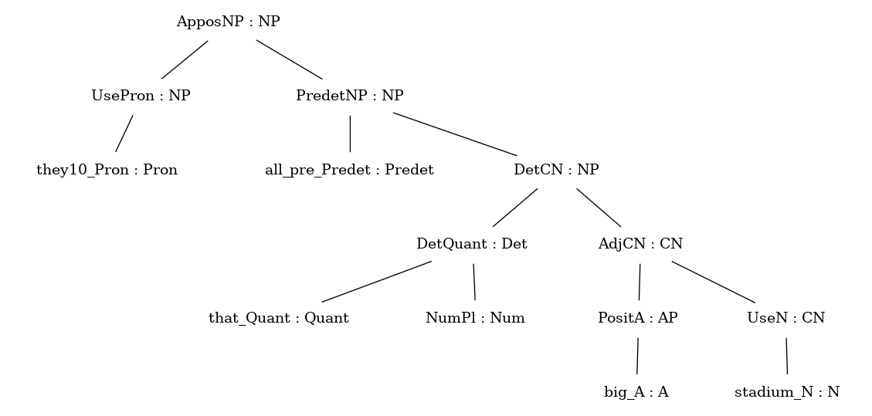
Noun phrases in GF
PredetNP all_pre_Predet (DetCN (DetQuant that_Quant NumPl) (AdjCN (PositA big_A) (UseN stadium_N)))
s | Full | Reduced | Poss | Loc
 | izinkundla | zinkundla | zinkundla | ezinkundleni
mod | ezinkulu
predet_pre | zo &+ nke
predet_post
agr | Third C9_10 Pl
qdef | Demonstrative Dem1
proDrop | False
isPron | False
empty
ApposNP : NP -> NP -> NP
I went to all those big stadiums
ngiye ezinkundleni lezi zonke ezinkulu
ngiye kuzo zonke lezi zinkundla ezinkulu
I went to them, all those big stadiums
Notes:
ApposCN won’t work, but ApposNP could capture this.
Now the question is: do we let the grammar overgenerate the wrong sentence, given that we can parse the correct form? Or do we implement a paraphrase? We’re not sure, so for now, we’re letting the grammar overgenerate. The thinking is that, at least for parsing, this helps reduce spurious results.

Slide 29
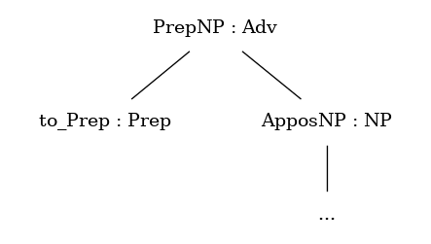
Locatives (“adverbs”)
kuzo zonke lezi zinkundla ezinkulu
to them, all those big stadiums
Notes:
Locatives are
A specific form of a regular noun
Certain noun classes
In order to express the idea of “to/towards something”, many languages use a preposition with a NP, and this is included in the RG syntax as PrepNP. So we need to start looking here if we want to implement this in Zulu.

Slide 30
Locatives (“adverbs”)
kuzo zonke lezi zinkundla ezinkulu
to them, all those big stadiums
in them, all those big stadiums
on them, all those big stadiums
below them, all those big stadiums
phakathi
phezulu
phansi
Notes:
Unfortunately, kuzo can mean to them, but also in them, on them, below them etc. In fact, there are no prepositions in Zulu. The closest we get to them are the locative nouns, such as phakathi (inside), phezulu (above), phansi (below) and so on. These are all class 16 nouns.
Anyway, they are not used to express location in general.

Slide 31
Locatives (“adverbs”)
kuzo zonke lezi zinkundla ezinkulu
to them, all those big stadiums
in them, all those big stadiums
on them, all those big stadiums
below them, all those big stadiums
phakathi
phezulu
phansi
LocNPAdv : NP -> Adv
KwaNPAdv : NP -> Adv
InstrNPAdv : NP -> Adv
KwaAdvNPAdv : Adv -> NP -> Adv
esitejini
kwa-Tatjana
ngamusa
ngaphezu kwesiteji
(to, in, on, below) the podium
at Tatjana’s place
graciously / with grace
on top of the podium
Notes:
So basically, we haven’t implemented PrepNP, because we haven’t implemented Prep as a category at all. Instead, we have some custom functions that use the locative forms of nouns to create adverbial phrases that function similarly to prepositional phrases.
LocNPAdv just calls up the locative form of the noun phrase, and it refers to in, on, below or whatever makes sense in the context.
KwaNPAdv can technically only be used with class 1a and 2a nouns, and it refers to someone’s place or home.
InstrNPAdv uses the instrumental prefix, and basically replaces the prepositional phrase containing with.
KwaAdvNPAdv uses adverbs (typically derived from the locative classes) and noun phrases to express spatial relations with more emphasis.

Slide 32
Locatives (“adverbs”)
kuzo zonke lezi zinkundla ezinkulu
to them, all those big stadiums
in them, all those big stadiums
on them, all those big stadiums
below them, all those big stadiums
phakathi
phezulu
phansi
LocNPAdv : NP -> Adv
KwaNPAdv : NP -> Adv
InstrNPAdv : NP -> Adv
KwaAdvNPAdv : Adv -> NP -> Adv
esitejini
kwa-Tatjana
ngamusa
ngaphezu kwesiteji
(to, in, on, below) the podium
at Tatjana’s place
graciously / with grace
on top of the podium
above_Adv
s | ngaphezu
reqLocS | False
Notes:
For now, the latter are treated as simple adverbs, namely, we have ngaphezu as an adverb in the lexicon. However, morphologically speaking, it is made up of the noun phezulu with the instrumental prefix.
Incidentally, the noun izulu, in class 5, means “sky”, so phezulu uses the same root with a different class prefix.

Slide 33
Quick verb morphology
Params
RForm | R_a | R_ile | R_e | R_i | R_anga
RInit | RA | RE | RI | RO | RU | RC
Syl | SylMono | SylMult
Voice | Active | Passive
Lincat of V, V2, VS
s | RForm => Str
r | RInit
syl | Syl
voice | Voice
bon_V2 (see)
s | R_a | R_ile | R_e | R_i | R_anga
 | bona | bonile | bone | boni | bonanga
r | RC
syl | SylMult
voice | Active
th_V2 (say)
s | R_a | R_ile | R_e | R_i | R_anga
 | thi | thile | the | thi | thanga
r | RC
syl | SylMono
voice | Active

Slide 34
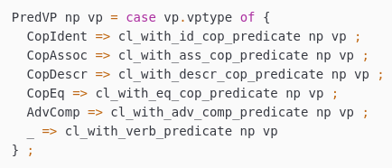
Quick verb morphology
Params
DMood | Princ | Part
Aspect | Null | Prog | Excl
BasicTense | PerfTense | PastTense | PresTense | FutTense
ZTense | Absolute BasicTense | Relative BasicTense BasicTense
VForm | VFIndic DMood Polarity BasicTense Aspect | VFPot DMood Polarity Aspect | VFSubj Polarity
VPType | CopIdent | CopAssoc | CopDescr | CopEq | VNPCompl | NoComp | VSCompl | AdvComp
Opers
rform | VForm -> Bool -> RForm = \vform,longform -> ...
tensePref, negPref, negPrefNga, negPrefNge | VForm -> Str = \vform -> ...
subjConc | VForm -> Agr -> Bool -> Str = \vform,agr,prevow -> ...
objConc | Agr -> RInit -> Syl -> Str = \agr,rinit,syl -> ...
a &+
ka &+
zu &+
zuza
= akazuzuza
Notes:
Different types of verb phrases requires different morpheme sequences when constructing clauses, relative clauses and imperatives.

Slide 35
Conclusion
Noun phrase is nearing completion
Next up: revamp TAMP
Current challenges
If wrong, how wrong?
Ambiguity, overgeneration, compiling
Future challenges
Multilingual lexicon/GF WordNet
Chunk-like parsing

